Slide 1


Topic - Angular
© Copyright 2021 Accolite. All Rights Reserved

Slide 2

About Me
Sharanya Mahesheka
Angular
Senior Software Engineer
Pritam has 2.5+ years of experience in the IT industry across the various domain
Expertise :
Java, Spring , Angular

Slide 3
About Me
Pritam Chowdhury
Angular
Senior Software Engineer
Pritam has 4+ years of experience in the IT industry across the various domain
Expertise :
Vanilla JS
Framework(Angular, AngularJs)
Extras: HTML, CSS

Slide 4

Agenda
01
Introduction
Angular CLi
Modules
Components
Data Binding
Lifecycle Hooks
Services and DI
Forms
02
03
04
05
06
07
08

Slide 5
Agenda
01
Directive
Component Interaction
Event Binding
Property Binding
Pipes
Observable
Rxjs
DI
Http Client
Routing and Navigation
Questions
02
03
04
05
06
07
08
09

Slide 6
Introduction
What is Angular?
Angular 7 is a JavaScript (actually a TypeScript based open-source full-stack web application) framework which makes you able to create reactive Single Page Applications (SPAs).
Angular empowers developers to build applications that live on the web, mobile, or the desktop
Notes:
Angular 7 is completely based on components. It consists of several components which forms a tree structure with parent and child components. Angular's versions beyond 2+ are generally known as Angular only. The very first version Angular 1.0 is known as AngularJS.
"Angular is a complete rewrite of AngularJS by the same team that built AngularJS."
A single page application is a web application or a website which provides users a very fluid, reactive and fast experience similar to a desktop application. It contains menu, buttons and blocks on a single page and when a user clicks on any of them; it dynamically rewrites the current page rather than loading entire new pages from a server. That's the reason behind its reactive fast speed.

Slide 7
Introduction
What is Angular?
●Open Source
●Backed by Google
●Large Developer Community
●Regular Updates
●World Wide ng Conference.
●Readily available open source components.
Notes:
Angular 7 is completely based on components. It consists of several components which forms a tree structure with parent and child components. Angular's versions beyond 2+ are generally known as Angular only. The very first version Angular 1.0 is known as AngularJS.
"Angular is a complete rewrite of AngularJS by the same team that built AngularJS."
A single page application is a web application or a website which provides users a very fluid, reactive and fast experience similar to a desktop application. It contains menu, buttons and blocks on a single page and when a user clicks on any of them; it dynamically rewrites the current page rather than loading entire new pages from a server. That's the reason behind its reactive fast speed.

Slide 8
Overview
Why Angular?
Angular Supports multiple platforms
High Speed and performance
Full Stack Development
Productivity
Notes:
Angular is a complete framework of JavaScript. It provides Testing, animation and Accessibility. It provides full stack development along with Node.js, Express.js, and MongoDB.
Angular provides a better productivity due to its simple and powerful template syntax, command line tools and popular editors and IDEs.

Slide 9
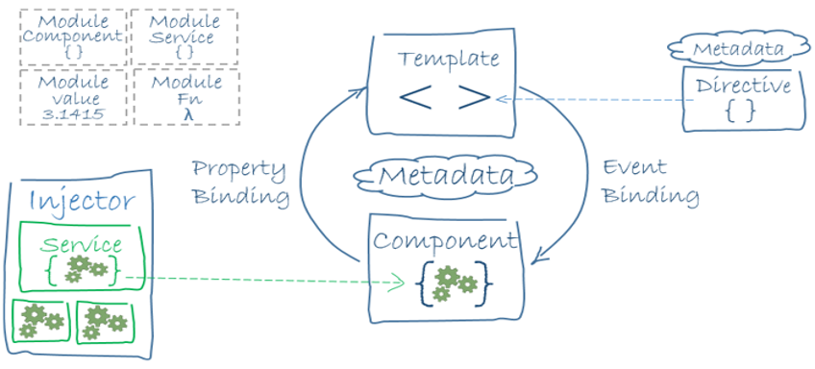
Architecture
Notes:
Angular is a complete framework of JavaScript. It provides Testing, animation and Accessibility. It provides full stack development along with Node.js, Express.js, and MongoDB.
Angular provides a better productivity due to its simple and powerful template syntax, command line tools and popular editors and IDEs.

Slide 10
Angular Cli
What is Angular Cli?
Angular CLI is a command-line interface (CLI) to automate your development workflow. It allows you to:
create a new Angular application
run a development server with LiveReload support to preview your application during development
add features to your existing Angular application
run your application’s unit tests
run your application’s end-to-end (E2E) tests
build your application for deployment to production.

Slide 11
Angular Cli
Ng new
Running the command ng new my-app will do the following:
a new directory my-app is created
all source files and directories for your new Angular application are created based on the name you specified (my-app) and best-practices from the official Angular Style Guide
npm dependencies are installed
TypeScript is configured for you
the Karma unit test runner is configured for you
the Protractor end-to-end test framework is configured for you
environment files with default settings are created.

Slide 12
Angular Cli
Commands
●ng serve: to start the built-in development server on default port
●ng test: to run all unit tests
●ng e2e: to run all E2E tests
●ng build --target=production: To build and bundle your application for deployment

Slide 13
Setup
Commands
Download Visual Studio Code
Download Node.js
Install Angular client
npm install -g @angular/cli
ng new spring-au
cd spring-au
ng serve

Slide 14
Setup
Explanation
src folder: This is the folder which contains the main code files related to your angular application.
app folder: The app folder contains the files, you have created for app components.
app.component.css: This file contains the cascading style sheets code for your app component.
app.component.html: This file contains the html file related to app component. This is the template file which is used by angular to do the data binding.
app.component.spec.ts: This file is a unit testing file related to app component. This file is used along with other unit tests. It is run from Angular CLI by the command ng test.
app.component.ts: This is the most important typescript file which includes the view logic behind the component.
app.module.ts: This is also a typescript file which includes all the dependencies for the website. This file is used to define the needed modules to be imported, the components to be declared and the main component to be bootstrapped..
Notes:
package.json: This is npm configuration file. It includes details about your website's package dependencies along with details about your own website being a package itself.
package-lock.json : This is an auto-generated and modified file that gets updated whenever npm does an operation related to node_modules or package.json
angular.json: It is very important configuration file related to your angular application. It defines the structure of your app and includes any settings associated with your application. Here, you can specify environments on this file (development, production). This is the file where we add Bootstrap file to work with Angular 7.
.gitignore: This file is related to the source control git.

Slide 15
Modules
What are Modules?
●Organizing your code into distinct functional modules helps in managing development of complex applications, and in designing for reusability.
●This technique lets you take advantage of lazy-loading—that is, loading modules on demand—in order to minimize the amount of code that needs to be loaded at startup.
NgModules allow their own functionality to be exported and used by other NgModules. For example, if you want to use the router service in your app, you can import the Router NgModule
Module in Angular refers to a place where you can group the components, directives, pipes, and services, which are related to the application
.

Slide 16
Components
What are Components?
●The @Component decorator identifies the class immediately below it as a component, and provides the template and related component-specific metadata.
●You define a component's view with its companion template.
●A template is a form of HTML that tells Angular how to render the component.
●Components define views, which are sets of screen elements that Angular can choose among and modify according to your program logic and data.
●Every app has at least a root component.
●Components use services, which provide specific functionality not directly related to views.

Slide 17
Templates
●A template looks like regular HTML, except that it also contains Angular template syntax.
●Angular template syntax alters the HTML based on your app's logic and the state of app and DOM data.
●Templates can use
○data binding to coordinate the app and DOM data.
○pipes to transform data before it is displayed
○directives to apply app logic to what gets displayed.

Slide 18
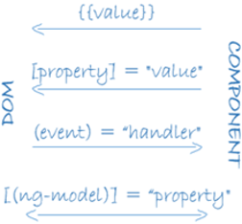
Data Binding

Slide 19
Data Binding
●Angular processes all data bindings once per JavaScript event cycle, from the root of the application component tree through all child components.
●Data binding plays an important role in communication between a template and its component
●It is also important for communication between parent and child components.

Slide 20
LifeCycle Hooks
●A component has a lifecycle managed by Angular.
●Angular creates it, renders it, creates and renders its children, checks it when its data-bound properties change, and destroys it before removing it from the DOM.
●Angular offers lifecycle hooks that provide visibility into these key life moments and the ability to act when they occur.
●This can be done by implementing one or more of the lifecycle hook interfaces in the Angular core library.
Notes:
ngOnChanges − When the value of a data bound property changes, then this method is called.
ngOnInit − This is called whenever the initialization of the directive/component after Angular first displays the data-bound properties happens.
ngDoCheck − This is for the detection and to act on changes that Angular can't or won't detect on its own.
ngAfterContentInit − This is called in response after Angular projects external content into the component's view.
ngAfterContentChecked − This is called in response after Angular checks the content projected into the component.
ngAfterViewInit − This is called in response after Angular initializes the component's views and child views.
ngAfterViewChecked − This is called in response after Angular checks the component's views and child views.
ngOnDestroy − This is the cleanup phase just before Angular destroys the directive/component.

Slide 21
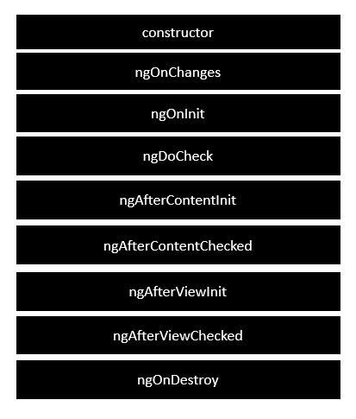
LifeCycle Hooks
Notes:
ngOnChanges − When the value of a data bound property changes, then this method is called.
ngOnInit − This is called whenever the initialization of the directive/component after Angular first displays the data-bound properties happens.
ngDoCheck − This is for the detection and to act on changes that Angular can't or won't detect on its own.
ngAfterContentInit − This is called in response after Angular projects external content into the component's view.
ngAfterContentChecked − This is called in response after Angular checks the content projected into the component.
ngAfterViewInit − This is called in response after Angular initializes the component's views and child views.
ngAfterViewChecked − This is called in response after Angular checks the component's views and child views.
ngOnDestroy − This is the cleanup phase just before Angular destroys the directive/component.

Slide 22
Services
Service is a broad category encompassing any value, function, or feature that an app needs. A service is typically a class with a narrow, well-defined purpose. It should do something specific and do it well.
Angular distinguishes components from services to increase modularity and reusability.
Notes:
We might come across a situation where we need some code to be used everywhere on the page. For example, it can be for data connection that needs to be shared across components. This is achieved with the help of Services. With services, we can access methods and properties across other components in the entire project.

Slide 23
Dependency Injection
The injector is the main mechanism. Angular creates an application-wide injector for you during the bootstrap process, and additional injectors as needed. You don't have to create injectors.
An injector creates dependencies, and maintains a container of dependency instances that it reuses if possible.
A provider is an object that tells an injector how to obtain or create a dependency.
A dependency doesn't have to be a service—it could be a function, for example, or a value.
Notes:
We might come across a situation where we need some code to be used everywhere on the page. For example, it can be for data connection that needs to be shared across components. This is achieved with the help of Services. With services, we can access methods and properties across other components in the entire project.

Slide 24
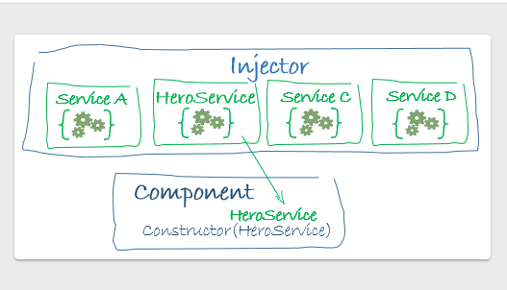
Services
Notes:
We might come across a situation where we need some code to be used everywhere on the page. For example, it can be for data connection that needs to be shared across components. This is achieved with the help of Services. With services, we can access methods and properties across other components in the entire project.

Slide 25
Directive
A directive allows you to attach a behavior to DOM elements
There are three kinds of directives in Angular:
Components—directives with a template.
Structural directives—change the DOM layout by adding and removing DOM elements.
Attribute directives—change the appearance or behavior of an element, component, or another directive.
ng generate directive highlight
Notes:
We might come across a situation where we need some code to be used everywhere on the page. For example, it can be for data connection that needs to be shared across components. This is achieved with the help of Services. With services, we can access methods and properties across other components in the entire project.

Slide 26
Overview
Structural Directives
Structural directives alter layout by adding, removing, and replacing elements in DOM.
*ngFor is an iterative; it tells Angular to generate the tags to the size of the list.
*ngIf is a conditional; it includes the element on the DOM if expression evaluates to true.
Ex: <li *ngFor="let hero of heroes"></li>
<app-hero-detail *ngIf="selectedHero"></app-hero-detail>
.

Slide 27
Overviw
Attribute Directives
Attribute directives alter the appearance or behavior of an existing element.
In templates they look like regular HTML attributes, hence the name.
Angular has pre-defined directives that either alter the layout structure (for example, ngSwitch) or modify aspects of DOM elements and components (for example, ngModel, ngStyle and ngClass).
[ngClass]="{'my-class': step === 'step1'}"
.

Slide 28
Overviw
Component Interaction
A common pattern in Angular is sharing data between a parent component and one or more child components.
You can implement this pattern by using the @Input() and @Output() directives.
@Input() allows a parent component to update data in the child component
@Output() allows the child to send data to a parent component.
.

Slide 29
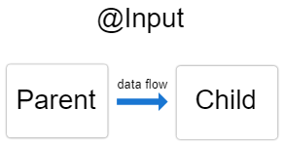
Overviw
Component Interaction
.
export class ItemDetailComponent {
@Input() item: string; // decorate the property with @Input()
}
<app-item-detail [item]="currentItem"></app-item-detail>

Slide 30
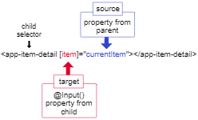
Overviw
Component Interaction
.

Slide 31
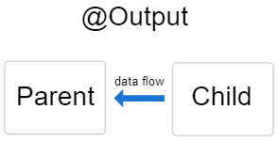
Overviw
Component Interaction
.

Slide 32
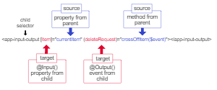
Overviw
Component Interaction
.

Slide 33
Overviw
Property Binding
Property binding in Angular helps you set values for properties of HTML elements or directives.
With property binding, you can do things such as toggle button functionality, set paths programmatically
You Can share data between component using property binding.
To bind to an element's property, enclose it in square brackets, [], which identifies the property as a target property
<img [src]="itemImageUrl">
The brackets, [], cause Angular to evaluate the right-hand side of the assignment as a dynamic expression. Without the brackets, Angular treats the right-hand side as a string literal and sets the property to that static value.
.

Slide 34
Overviw
Property Binding
<button [disabled]="isUnchanged">Disabled Button</button>
To disable a button's functionality depending on a Boolean value, bind the DOM disabled property to a property in the class that is true or false
<app-item-detail [childItem]="parentItem"></app-item-detail>
To set the model property of a custom component, place the target, here childItem, between square brackets [] followed by an equal sign and the property. Here, the property is parentItem.
.

Slide 35
Overviw
Event Binding
Event binding allows us to bind events such as keystroke, clicks, hover, touche, etc to a method in component.
It is one way from view to component
Angular event binding syntax consists of a target event name within parentheses on the left of an equal sign, and a quoted template statement on the right.
.

Slide 36
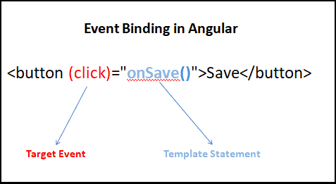
Overviw
Event Binding
.

Slide 37
Basics
Pipes
Angular pipes let you declare display-value transformations in your template HTML.
A class with the @Pipe decorator defines a function that transforms input values to output values for display in a view.
Angular defines various pipes, such as the date pipe and currency pipe
To specify a value transformation in an HTML template, use the pipe operator |
You can chain pipes, sending the output of one pipe function to be transformed by another pipe function.
A pipe can also take arguments that control how it performs its transformation.
The arguments are given with a : operator
Ex: <p>The date is {{today | date:'fullDate'}}</p>
Notes:
Data types
The latest ECMAScript standard defines seven data types:
Six data types that are primitives:
Boolean. true and false.
null. A special keyword denoting a null value. Because JavaScript is case-sensitive, null is not the same as Null, NULL, or any other variant.
undefined. A top-level property whose value is undefined.
Number. 42 or 3.14159.
String. "Howdy"
Symbol (new in ECMAScript 2015). A data type whose instances are unique and immutable.
and Object

Slide 38
Observable
Observables provide support for passing messages between publishers and subscribers in your application.
Observables offer significant benefits over other techniques for event handling, asynchronous programming, and handling multiple values.
Observables are declarative—that is, you define a function for publishing values, but it is not executed until a consumer subscribes to it.
Notes:
Declaring variables
You can declare a variable in three ways:
With the keyword var. For example, var x = 42. This syntax can be used to declare both local and global variables.
By simply assigning it a value. For example, x = 42. This always declares a global variable. It generates a strict JavaScript warning. You shouldn't use this variant.
With the keyword let. For example, let y = 13. This syntax can be used to declare a block scope local variable. See Variable scope below.
Evaluating variables
A variable declared using the var statement with no initial value specified has the value undefined.
An attempt to access an undeclared variable or an attempt to access an identifier declared with let statement before initialization will result in a ReferenceError exception being thrown:
var a; console.log("The value of a is " + a); // logs "The value of a is undefined" console.log("The value of b is " + b); // throws ReferenceError exception console.log("The value of x is " + x); // throws ReferenceError exception let x;

Slide 39
Basics
Observable
The subscribed consumer receives notifications until the function completes, or until they unsubscribe.
An observable can deliver multiple values of any type—literals, messages, or events, depending on the context.
The API for receiving values is the same whether the values are delivered synchronously or asynchronously.
Notes:
You can use undefined to determine whether a variable has a value. In the following code, the variableinput is not assigned a value, and the if statement evaluates to true.
var input; if(input === undefined){ doThis(); } else { doThat(); }
The undefined value behaves as false when used in a boolean context. For example, the following code executes the function myFunction because the myArray element is undefined:
var myArray = []; if (!myArray[0]) myFunction();
The undefined value converts to NaN when used in numeric context.
var a; a + 2; // Evaluates to NaN
When you evaluate a null variable, the null value behaves as 0 in numeric contexts and as false in boolean contexts. For example:
var n = null; console.log(n * 32); // Will log 0 to the console

Slide 40
Basics
Observable
A publisher creates an Observable instance that defines a subscriber function.
Subscriber function is executed when a consumer calls the subscribe() method.
The subscriber function defines how to obtain or generate values or messages to be published.
The subscribe() call returns a Subscription object that has an unsubscribe() method, which you call to stop receiving notifications.
Notes:
Data type conversion
JavaScript is a dynamically typed language. You don't have to specify the data type of a variable when you declare it.
var answer = 42;
And later, you could assign the same variable a string value, for example:
answer = "Thanks for all the fish...";
Because JavaScript is dynamically typed, this assignment does not cause an error message.
In expressions involving numeric and string values with the + operator, JavaScript converts numeric values to strings. For example, consider the following statements:
x = "The answer is " + 42 // "The answer is 42" y = 42 + " is the answer" // "42 is the answer"
In statements involving other operators, JavaScript does not convert numeric values to strings. For example:
"37" - 7 // 30 "37" + 7 // "377"

Slide 41
Basics
DI
DI stands for dependency injection.
Dependencies are services or objects that a class needs to perform its function. Dependency injection, or DI, is a design pattern in which a class requests dependencies from external sources rather than creating them..
Angular's DI framework provides dependencies to a class upon instantiation. You can use Angular DI to increase flexibility and modularity in your applications.
Generally we create an injectable service and inject it to a component
To a constructor function
Constructor(public heroserivce:HeroService)
Notes:
Data type conversion
JavaScript is a dynamically typed language. You don't have to specify the data type of a variable when you declare it.
var answer = 42;
And later, you could assign the same variable a string value, for example:
answer = "Thanks for all the fish...";
Because JavaScript is dynamically typed, this assignment does not cause an error message.
In expressions involving numeric and string values with the + operator, JavaScript converts numeric values to strings. For example, consider the following statements:
x = "The answer is " + 42 // "The answer is 42" y = 42 + " is the answer" // "42 is the answer"
In statements involving other operators, JavaScript does not convert numeric values to strings. For example:
"37" - 7 // 30 "37" + 7 // "377"

Slide 42
Basics
Rxjs
RxJS (Reactive Extensions for JavaScript) is a library for reactive programming using observables that makes it easier to compose asynchronous or callback-based code.
RxJs has few operator and functions that that facilitate coding
We can make debouncing effect using Rxjs functions
Few Frequntly jused rxjs functions are
Debounce time (discard emissions until a set amount of time passed after the last one and then return that last one.)
Take until (stop emitting after the given observable emits.)
Notes:
Data type conversion
JavaScript is a dynamically typed language. You don't have to specify the data type of a variable when you declare it.
var answer = 42;
And later, you could assign the same variable a string value, for example:
answer = "Thanks for all the fish...";
Because JavaScript is dynamically typed, this assignment does not cause an error message.
In expressions involving numeric and string values with the + operator, JavaScript converts numeric values to strings. For example, consider the following statements:
x = "The answer is " + 42 // "The answer is 42" y = 42 + " is the answer" // "42 is the answer"
In statements involving other operators, JavaScript does not convert numeric values to strings. For example:
"37" - 7 // 30 "37" + 7 // "377"

Slide 43
Basics
Http Client
The HttpClient offers a simplified API for Angular applications that rests on the XMLHttpRequest interface exposed by browsers.
Additional benefits of HttpClient include
testability features,
typed request and response objects,
request and response interception,
Observable apis,
and streamlined error handling.
Notes:
There are global fundamental functions like parseInt() and parseFloat()
Converting strings to numbers
In the case that a value representing a number is in memory as a string, there are methods for conversion.
parseInt()
parseFloat()
parseInt will only return whole numbers, so its use is diminished for decimals. Additionally, a best practice for parseInt is to always include the radix parameter. The radix parameter is used to specify which numerical system is to be used.
An alternative method of retrieving a number from a string is with the + (unary plus) operator:
"1.1" + "1.1" = "1.11.1" (+"1.1") + (+"1.1") = 2.2 // Note: the parentheses are added for clarity, not required.

Slide 44
Literals
Http Client
Error inspection, interpretation, and resolution is something you want to do in the service, not in the component.
An HttpClient method does not begin its HTTP request until you call subscribe() on the observable returned by that method. This is true for all HttpClient methods.
One can create interceptors that can inspect and transform HTTP requests to/from the server
Notes:
Converting strings to numbers
In the case that a value representing a number is in memory as a string, there are methods for conversion.
parseInt()
parseFloat()
parseInt will only return whole numbers, so its use is diminished for decimals. Additionally, a best practice for parseInt is to always include the radix parameter. The radix parameter is used to specify which numerical system is to be used.
An alternative method of retrieving a number from a string is with the + (unary plus) operator:
"1.1" + "1.1" = "1.11.1" (+"1.1") + (+"1.1") = 2.2 // Note: the parentheses are added for clarity, not required.

Slide 45
Literals
Routing And Navigation
The Angular Router enables navigation from one view to the next as users perform application tasks.
Router logs activity in the browser's history journal so the back and forward buttons work as well.
A routed Angular application has one singleton instance of the Router service. When the browser's URL changes, that router looks for a corresponding Route from which it can determine the component to display.
Notes:
Array literals
An array literal is a list of zero or more expressions, each of which represents an array element, enclosed in square brackets ([]). When you create an array using an array literal, it is initialized with the specified values as its elements, and its length is set to the number of arguments specified.
The following example creates the coffees array with three elements and a length of three:
var coffees = ["French Roast", "Colombian", "Kona"];
Note : An array literal is a type of object initializer. See Using Object Initializers.
If an array is created using a literal in a top-level script, JavaScript interprets the array each time it evaluates the expression containing the array literal. In addition, a literal used in a function is created each time the function is called.
Array literals are also Array objects. See Array and Indexed collections for details on Array objects.
Extra commas in array literals
You do not have to specify all elements in an array literal. If you put two commas in a row, the array is created with undefined for the unspecified elements. The following example creates the fish array:
var fish = ["Lion", , "Angel"];
This array has two elements with values and one empty element (fish[0] is "Lion", fish[1] isundefined, and fish[2] is "Angel").
If you include a trailing comma at the end of the list of elements, the comma is ignored. In the following example, the length of the array is three. There is no myList[3]. All other commas in the list indicate a new element.
Note : Trailing commas can create errors in older browser versions and it is a best practice to remove them.
var myList = ['home', , 'school', ];
In the following example, the length of the array is four, and myList[0] and myList[2] are missing.
var myList = [ , 'home', , 'school'];
In the following example, the length of the array is four, and myList[1] and myList[3] are missing. Only the last comma is ignored.
var myList = ['home', , 'school', , ];
Understanding the behavior of extra commas is important to understanding JavaScript as a language, however when writing your own code: explicitly declaring the missing elements as undefined will increase your code's clarity and maintainability.

Slide 46
Routing & Navigation
A router has no routes until you configure it.
Most routing applications should add a <base> element to the index.html as the first child in the <head> tag to tell the router how to compose navigation URLs.
Ex: <base href="/">
Import RouterModule from router module.
Ex: import { RouterModule, Routes } from '@angular/router';
Each Route maps a URL path to a component.
Literals
Notes:
Boolean literals
The Boolean type has two literal values: true and false.
Do not confuse the primitive Boolean values true and false with the true and false values of the Boolean object. The Boolean object is a wrapper around the primitive Boolean data type. See Booleanfor more information.
Integers
Integers can be expressed in decimal (base 10), hexadecimal (base 16), octal (base 8) and binary (base 2).
Decimal integer literal consists of a sequence of digits without a leading 0 (zero).
Leading 0 (zero) on an integer literal, or leading 0o (or 0O) indicates it is in octal. Octal integers can include only the digits 0-7.
Leading 0x (or 0X) indicates hexadecimal. Hexadecimal integers can include digits (0-9) and the letters a-f and A-F.
Leading 0b (or 0B) indicates binary. Binary integers can include digits only 0 and 1.
Some examples of integer literals are:
0, 117 and -345 (decimal, base 10) 015, 0001 and -0o77 (octal, base 8) 0x1123, 0x00111 and -0xF1A7 (hexadecimal, "hex" or base 16) 0b11, 0b0011 and -0b11 (binary, base 2)

Slide 47
Variable Scope
Routing and Naviagation
There are no leading slashes in the path.
The router parses and builds the final URL for you, allowing you to use both relative and absolute paths when navigating between application views.
The router uses a first-match wins strategy when matching routes, so more specific routes should be placed above less specific routes. Order of routes matters.
Notes:
When you declare a variable outside of any function, it is called a global variable, because it is available to any other code in the current document. When you declare a variable within a function, it is called a local variable, because it is available only within that function.
Block scope is not available in javascript.
JavaScript before ECMAScript 2015 does not have block statement scope; rather, a variable declared within a block is local to the function (or global scope) that the block resides within. For example the following code will log 5, because the scope of x is the function (or global context) within which x is declared, not the block, which in this case is an if statement.

Slide 48
QUIZ
What is the decorator used for configuring your module class?
A - @NgModule
B - @NgApp
C - Both
D - None of above
What does AOT stand for?
A - ahead-of-time compilation
B - Angular Object Templates
C - Both
D - None of above
Notes:
What to give here?

Slide 49
QUIZ
Which of the following is not a hook application life cycle?
A - ngOnChanges
B - ngViewStart
C - ngOnInit
D - None of above
Router is part of which of the following module?
A - @angular/core
B - @angular/router
C - Both
D - None of above
Notes:
What to give here?

Slide 50
QUIZ
What is .subscribe?
A - Streams data in asynchronously
B - Streams data in synchronously
C-BOTH
D - None of above
Which one of the following is structural directive?
A - ngIf
B -ngclass
C - Both
D - None of above
Notes:
What to give here?

Slide 51
QUIZ
Which one of the following is used to pass data between parent to child?
@Input
@Output
Both
None of these
Which one of the example of property binding?
A - <button [disabled]="isUnchanged">Disabled Button</button>
B -<button (click)="save()">Disabled Button</button>
C - Both
D - None of above
Notes:
What to give here?

Slide 52

Q & A
Any Question?

Slide 53



www.accolite.com
Thank You
twitter.com/weareaccolite
facebook.com/accolite
linkedin.com/company/accolite

